Slide 1
Week 4 Notes
PHY495: Hoop Never Misses

Slide 2
What I’ve Done
Tried to optimize the angle of the backboard for a number of different shots → this is still a work in progress
Some debugging on the two_d_shot.py file to make sure everything was working with the tolerance and the radius of the basketball
Lots of debugging in the monte carlo file to make sense of every line and check that it does what I want it to do

Slide 3
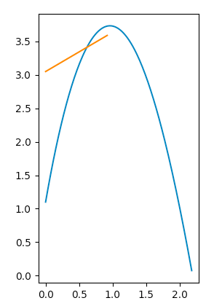
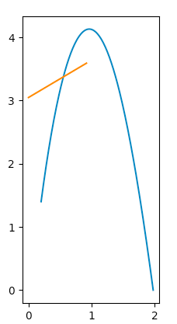
What Didn’t Work
Initially I ran into a problem where the ball was hitting the “wrong” side of the backboard – I fixed this by comparing the angle of the shot as it was hitting the backboard to the angle of the backboard

Slide 4
Where am I Stuck
How to extend lines 114-115 in two_d_shot.py to 3D code because there are two variables that we’re testing
Got an error about the square root not existing in line 114 of two_d_shot.py but I put it in a try-except block and it still is having an error
Something’s wrong with my for loop in the monte carlo file – it only runs for the first backboard angle

Slide 5
What Next?
Figure out energy lost by hitting the backboard (I’m just going to keep putting this in the slides, so I don’t forget)
Extend 2D code to 3D code and make sure it’s working fully
Fix monte carlo simulation to actually have functions hit the backboard and plot them

Slide 6
Sources

